Slide 1
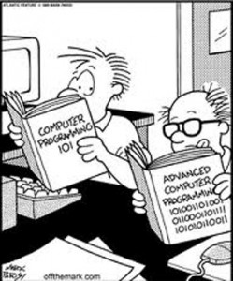
Intro to Python Programming – Part III
Hydroinformatics
October 2016
Dr. Dan Ames Brigham Young University dan.ames@byu.edu

Slide 2

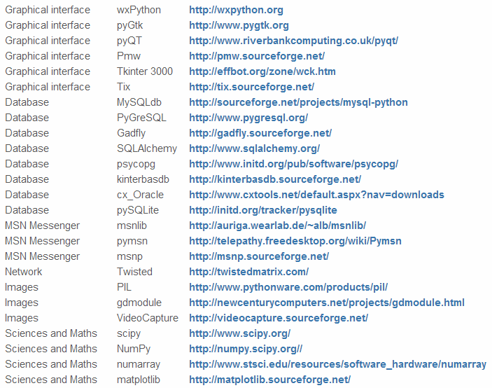
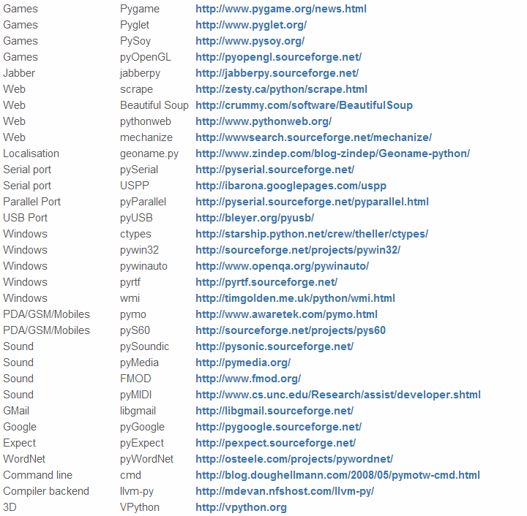

Python Modules
50 Top Python Modules (from www.CatsWhoCode.com)
Think Legos…

Slide 3
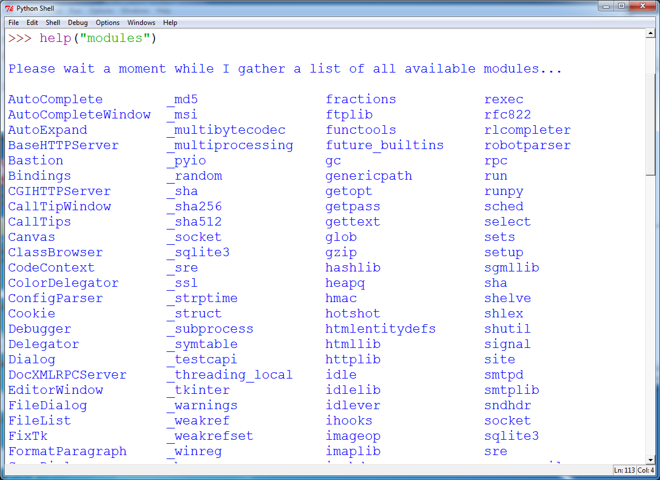
Here’s how to see what modules you currently have loaded…

Slide 4

Four useful modules
os: functions for working with your operating system including file management
shutil: high level functions for working with files
MatPlotLib: make graphs, charts, and maps
pymysql: functions for accessing and working with data in an SQL database

Slide 5
Module: OS
Let’s look at the module, “os”
Think of it as a connector into your current operating system
Use it to do useful file level activities
os.getcwd() returns the current working directory
os.curdir returns the current directory
os.execl executes an executable file
os.abort fails in the hardest way possible
os.listdir returns a list of strings of names of entries in a folder
os.path.exists() tests whether a path exists
os.path.basename() returns the final component of a path name
os.path.isdir() returns true for a directory, false for a filename

Slide 6
MODULE: shutil
Let’s look at the module, “shutil”
Think of it as a high level file/folder manipulator
shutil.copy, copyfile, copytree copy things
shutil.abspath returns the absolute path to a file
Shutil.fnmatch test if a file path matches a pattern
shutil.move move a file or folder to another destination
shutil.rmtree recursively remove the contents of a directory tree

Slide 7
MODULE: MatPlotLib
Let’s look at the module, “MatPlotLib”
Makes (pretty) pictures
MatPlotLib.pyplot.plot Plot a graph of data.
MatPlotLib.pyplot.show Show the user your graph.
Tutorial here: http://matplotlib.org/1.3.1/users/pyplot_tutorial.html
Gallery here: http://matplotlib.org/1.3.1/gallery.html

Slide 8
Module: pymysql
Retrieving Data
Go to your Python Console and type the following commands:
import pymysql
conn = pymysql.connect(host='127.0.0.1', unix_socket='/tmp/mysql.sock', user='root', passwd=None, db='mysql')
cur = conn.cursor()
cur.execute("SELECT * FROM odm.methods")
r = cur.fetchall()
print r
#returns a list of all rows in the methods table!

Slide 9
Module: pymysql
Let’s look at the module, “pymysql”
Think of it as a database connector
>>> import pymysql
Traceback (most recent call last):
File "<input>", line 1, in <module>
File "/Applications/PyCharm CE.app/Contents/helpers/pydev/pydev_import_hook.py", line 21, in do_import
module = self._system_import(name, *args, **kwargs)
ImportError: No module named pypyodbc
OOPS! What went wrong!?

Slide 10
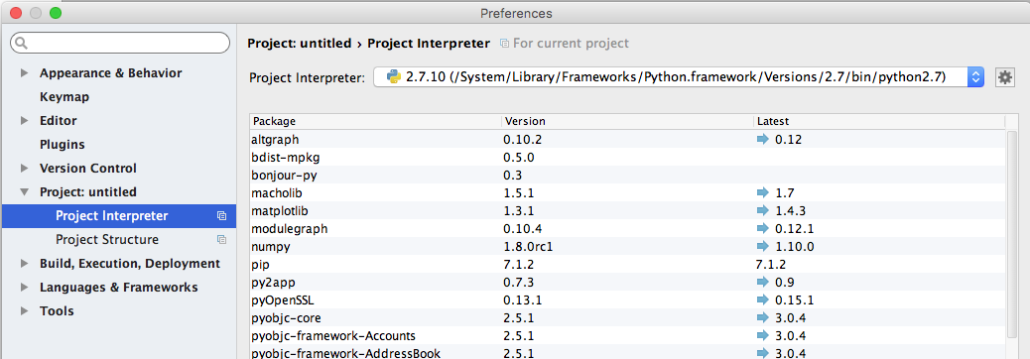
Module: pymysql (MAC)
Installing the module, “pymysql”
We need to “install” pymysql on y our computer before it is available for “import”
Go to “PyCharm” “Preferences” “Project Interpreter” and select the python 2.7 interpreter from the drop down list… This will show your available modules.

Slide 11
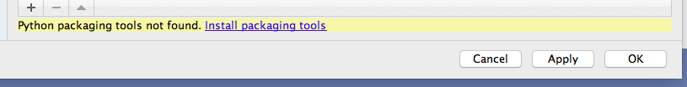
Module: pymysql (MAC)
Installing the module, “pymysql”
If “Python packaging tools not found” warning appears, then click the “Install packaging tools” link.
This will allow PyCharm to easily install packages/modules from online sites.

Slide 12
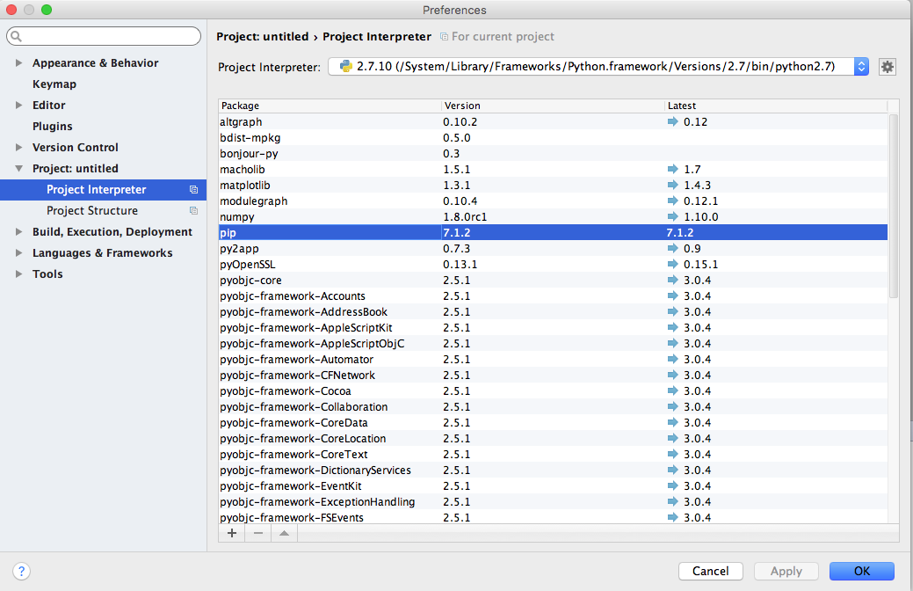
Module: pymysql (MAC)
Installing the module, “pymysql”
Upgrade the “pip” module if need be.
This is the module that actually installs other modules.
Click it in the list then click the “up” arrow to upgrade it.

Slide 13
Module: pymysql (MAC)
Installing the module, “pymysql”
Click the “+” button to add a new package/module

Slide 14
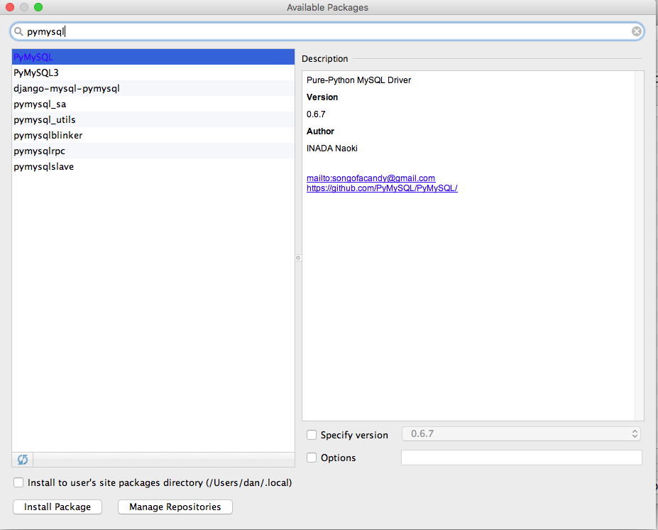
Module: pymysql (MAC)
Installing the module, “pymysql”
In the form that appears, type “pymysql” then select the pymysql package and click “Install Package”

Slide 15
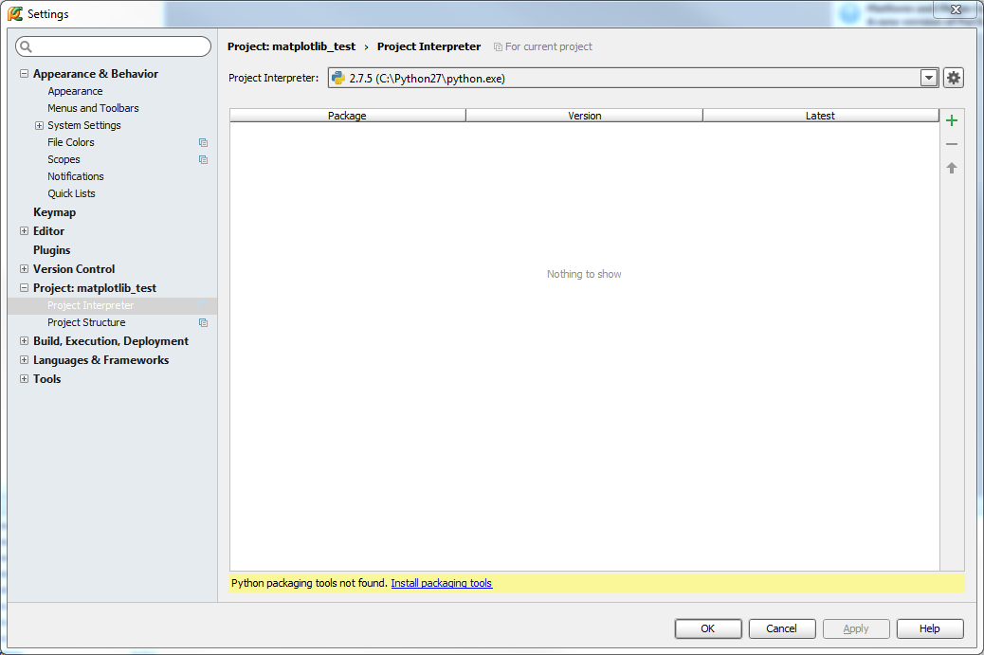
Module: pymysql (Windows)
Installing the module, “pymysql”
We need to “install” pymysql on your computer before it is available for “import”
Go to “File” “Settings” “Project Interpreter” “Project:…” “Project Interpreter” and select the Python 2.7 interpreter from the drop down list… This will show your available modules.

Slide 16
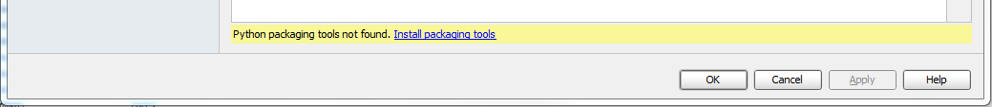
Module: pymysql (WINDOWS)
Installing the module, “pymysql”
If “Python packaging tools not found” warning appears, then click the “Install packaging tools” link.
This will allow PyCharm to easily install packages/modules from online sites.

Slide 17
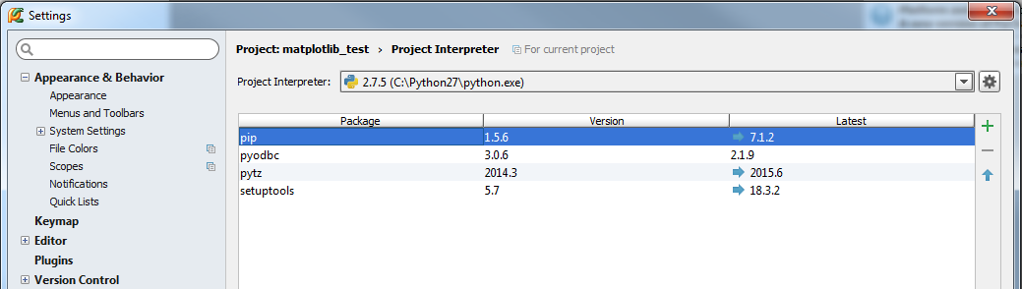
Module: pymysql (windows)
Installing the module, “pymysql”
Upgrade the “pip” module if need be.
This is the module that actually installs other modules.
Click it in the list then click the “up” arrow to upgrade it.

Slide 18
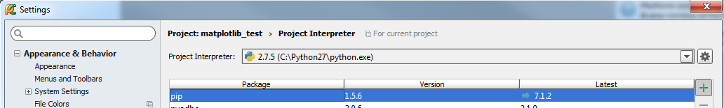
Module: pymysql (Windows)
Installing the module, “pymysql”
Click the “+” button to add a new package/module

Slide 19
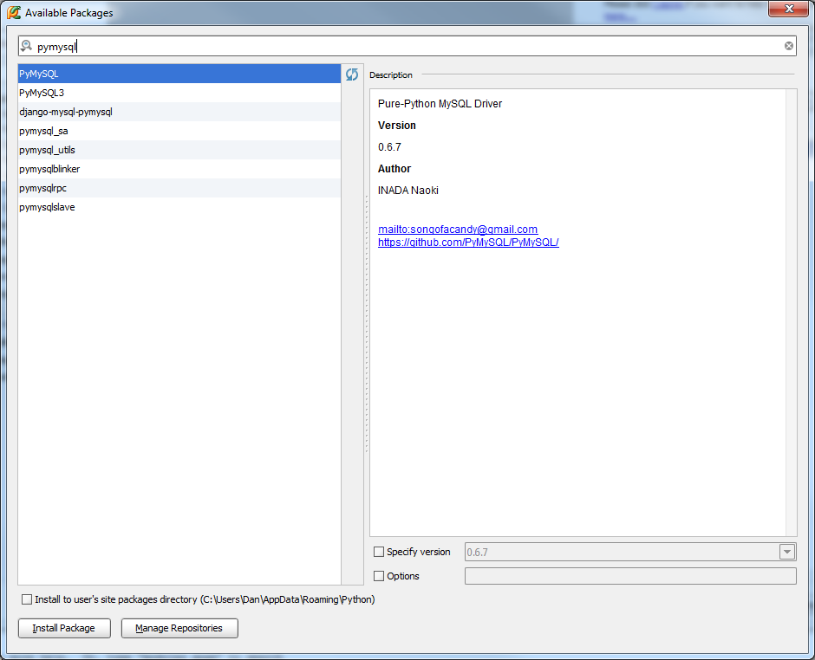
Module: pymysql (windows)
Installing the module, “pymysql”
In the form that appears, type “pymysql” then select the pymysql package and click “Install Package”

Slide 20
Module: pymysql
Let’s look at the module, “pymysql”
Think of it as a database connector
pymysql.connect connect to a database
connection.cursor a “pointer” to a row in a database
cursor.execute run an SQL query
cursor.fetchone get a row from a database
row.some_field_name returns the value of a field in a row

Slide 21
Module: pymysql (MAC)
Retrieving Data
Go to your Python Console and type the following commands:
import pymysql
conn = pymysql.connect(host='127.0.0.1', unix_socket='/tmp/mysql.sock', user='root', passwd=None, db='mysql')
cur = conn.cursor()
cur.execute("SELECT * FROM odm.methods")
r = cur.fetchall()
print r
#returns a list of all rows in the methods table!

Slide 22
Module: pymysql
Retrieving Data
Download the ODMFunctions.py script. Let’s look at it together…

